Slide 1
Discovering Termovent SC
Company Profile & Production Range

Slide 2
Let Us Introduce Termovent SC
01. Our Story
02. Production
03. Quality System
04. Production Range

Slide 3
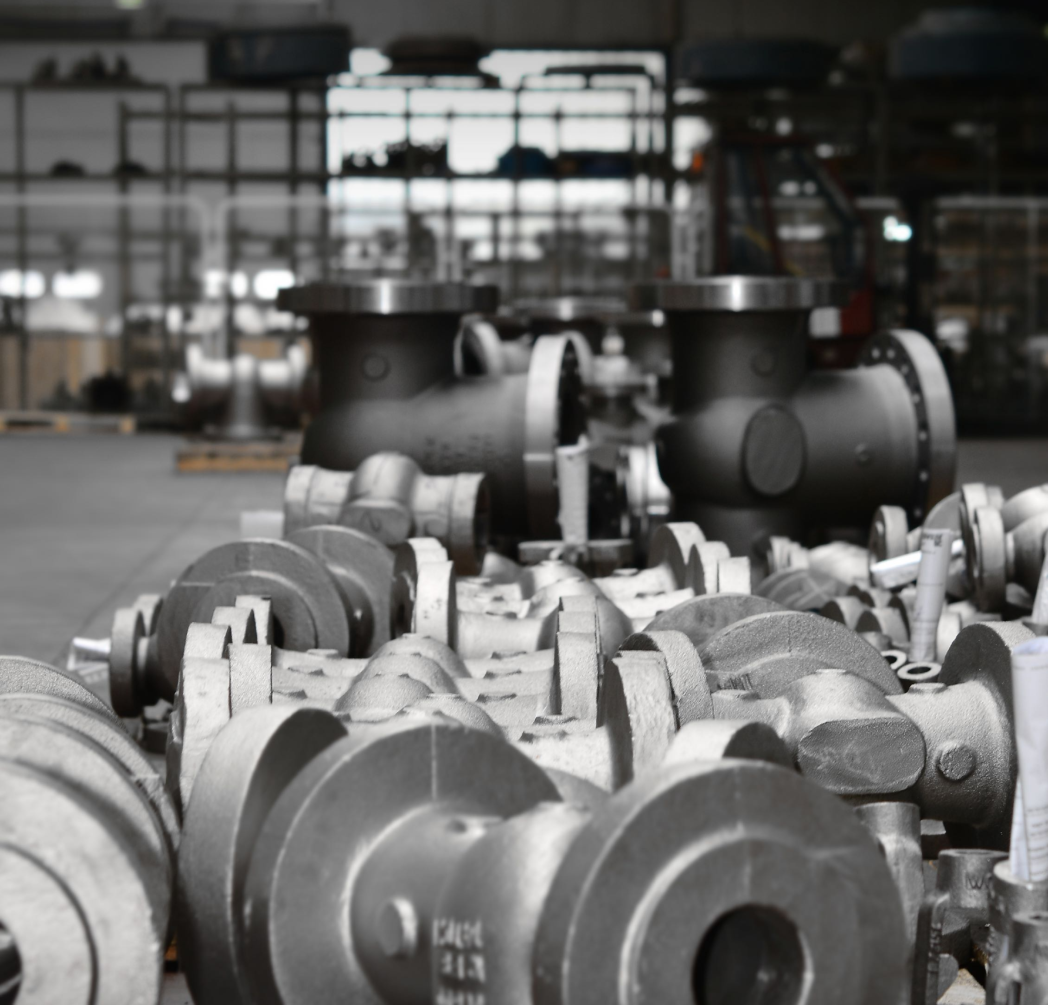
Our Story
We are TERMOVENT SC Company, a regional leader in production of industrial valves for process industry and thermo energetics.
We remained until today a company in private ownership and management structure, as for the past 50 years of presence.

Slide 4
Timeline
1963
1987
1996
The company was founded by Mr. Slobodan Crnogorac
First certification of Quality Management System
Start of production at the newly built factory in Temerin, Serbia

Slide 5
Next generation - Mr. Aleksandar Crnogorac becomes the new CEO of Termovent SC
2002
2003
2004
Certified according to European Directive 97/23 EC, since Termovent SC products carry CE-0035
Steel Foundry in 2003 has become a member of Termovent SC
The first investment in Steel Foundry - Induction Furnaces

Slide 6
Next important investment in the Foundry - Alfaset process moulding technology
2010
2013
2016
The American Petroleum Institute certifies Termovent SC and awarded The API Monograms
50 Years Anniversary
New investments in Termovnet SC 5-axis CNC Machining Center
GT Travisan DS 600

Slide 7
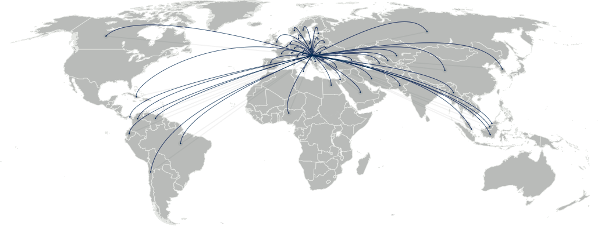
Today
Today, we are present with our products on almost all continents. TERMOVENT SC products are installed and functioning in many plants in more than 60 countries worldwide.

Slide 8
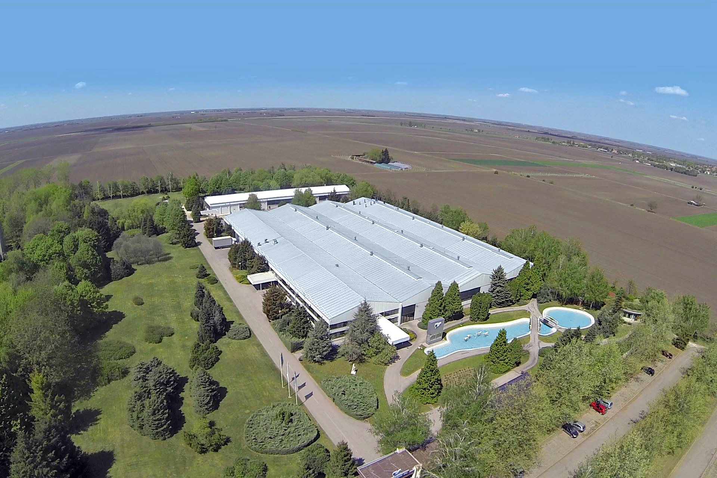
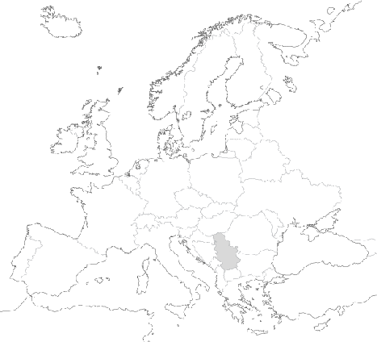
All in One Place
All of the product components are manufactured in Temerin Serbia, at our own manufacturing plant. The casting product components are made in our own TERMOVENT SC Steel Foundry in Backa Topola, Serbia.
Thus we can guarantee high quality of TERMOVENT SC valves.

Slide 9
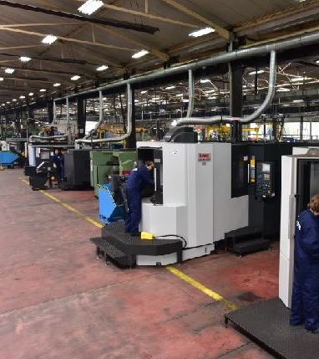
Valve Plant
TERMOVENT SC Temerin, production site with a comprehensive infrastructure, all necessary equipment for long-range future activities and with modern work environment, in which the production started in 1996. Production of Industrial valves for power plants, pipelines, refineries and industrial plants of any kind.
140
EMPLOYEES
9.000 m²
OF PRODUCTION SPACE
Production of INDUSTRIAL VALVES

Slide 10
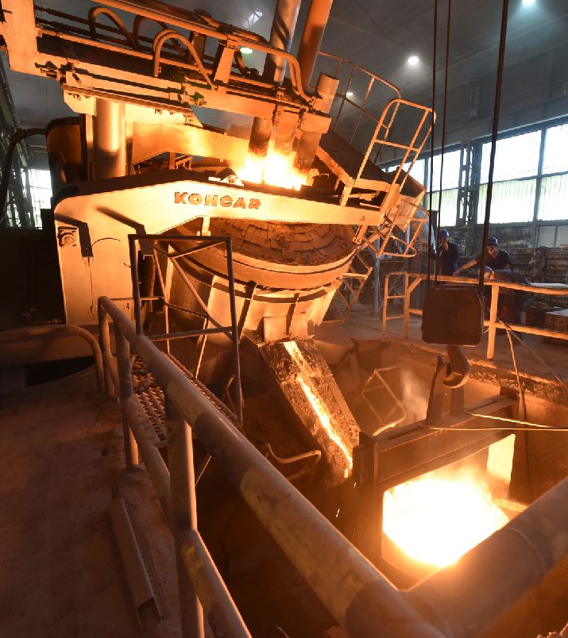
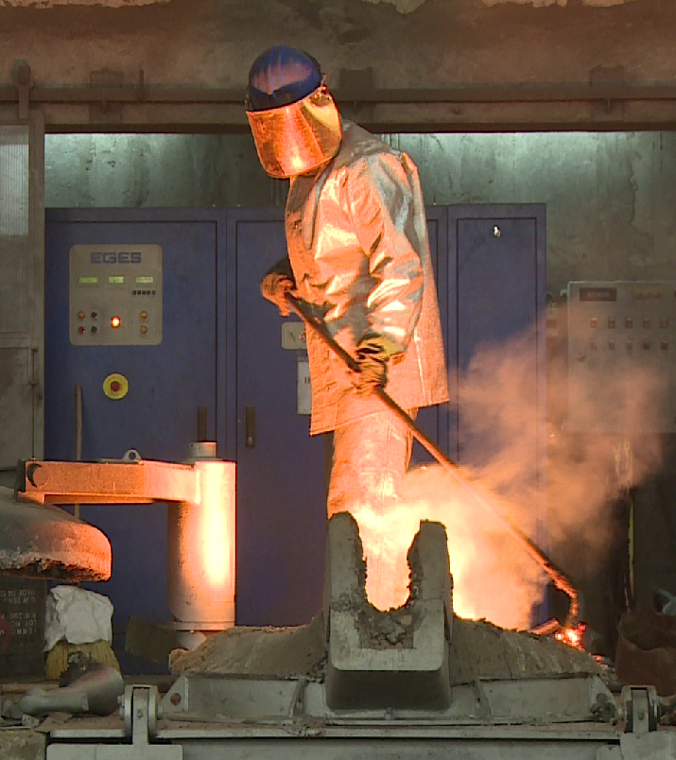
Steel Foundry
All casting product components are made in our own TERMOVENT SC Steel Foundry in Backa Topola, Serbia. Our long-standing supplier of castings Steel Foundry has become a member of our company since 2003.
225
EMPLOYEES
8.500 m²
OF PRODUCTION SPACE
Production of STEEL CASTINGS

Slide 11
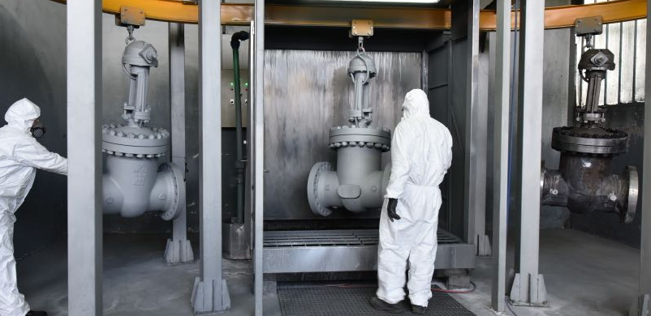
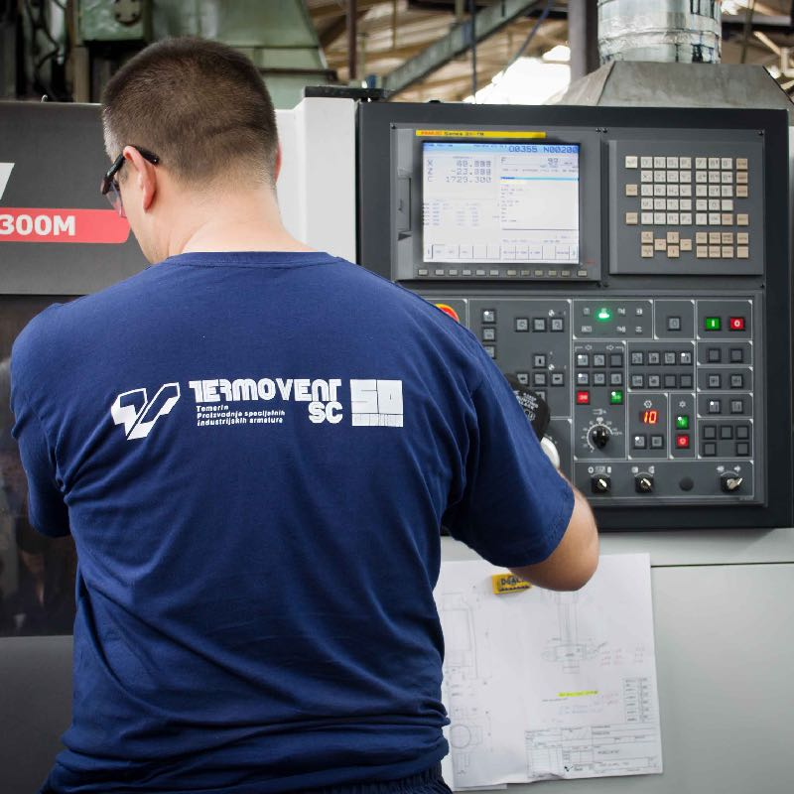
Production Capacities
TERMOVENT SC’s ongoing investments into the latest machines and process technology is the key factor for continuously increasing productivity ensuring accurate, efficient and high quality production of valve components.

Slide 12
Machinery
5-axis CNC Machining Center // 2 pcs.
CNC - Lathes // 8 pcs.
CNC Horizontal Machining Centers // 2 pcs.
CNC Metal Saw // 3 pcs.
Automatic Welding Machines // 4 pcs.
Vertical Lathes (Carousel) // 2 pcs.
Universal Lathes // 24 pcs.
Drilling Machines // 9 pcs.
Milling Machines // 7 pcs.
Horizontal Boring / Milling / Turning Machine (Borwerk) // 4 pcs.
We feature highly developed production capacities. TERMOVENT SC is continuously investing in latest machines and process technologies, every year. This way we can increase our productivity and achieve a successful and good quality production.
Grinding Machines // 3 pcs.
Lapping Machines // 3 pcs.
Automatic Painting Lines / 2 pcs.
Thread Rolling Machine

Slide 13
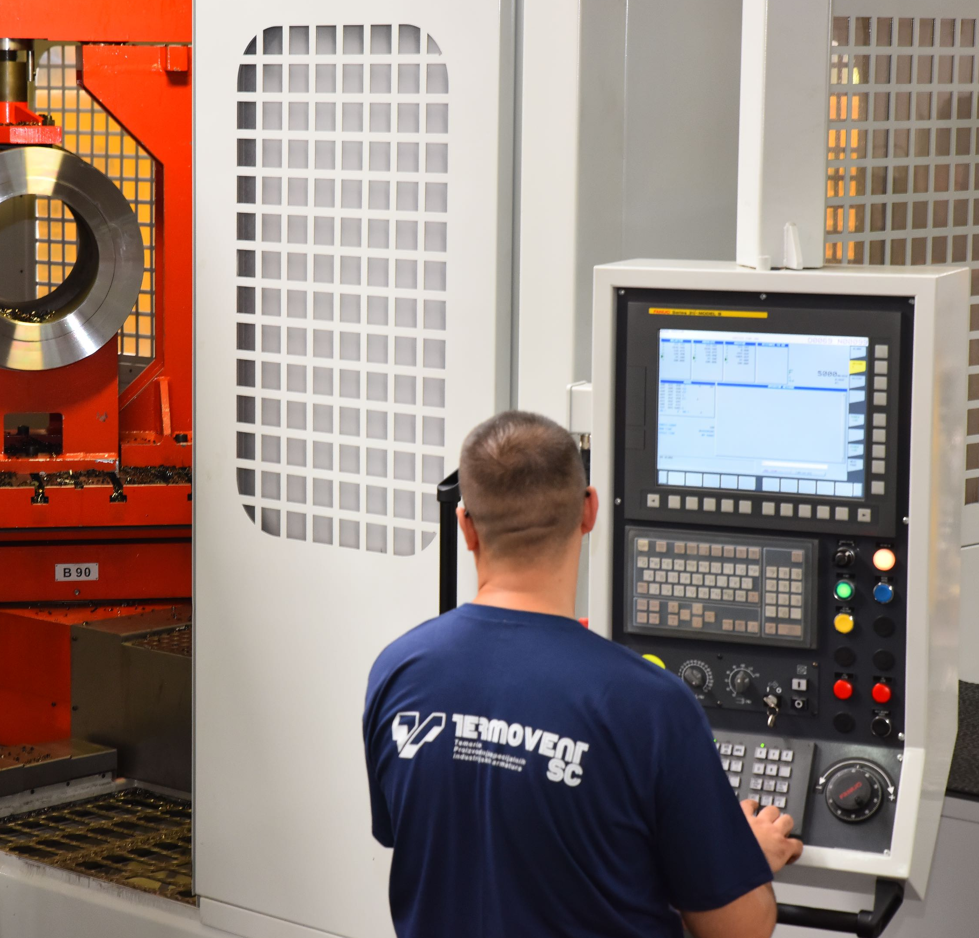
Reliable Quality
Design, process planning, casting, machining, assembly, testing, surface treatment, logistic and quality management integrated in our own plants is crucial for ensuring the constant high quality of TERMOVENT SC products.

Slide 14
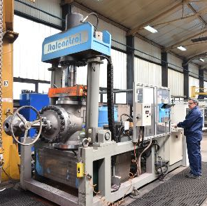
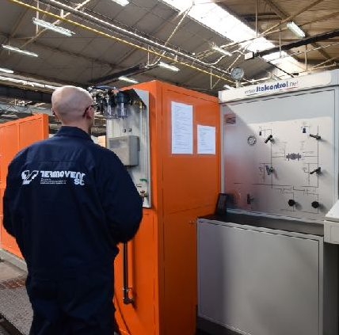
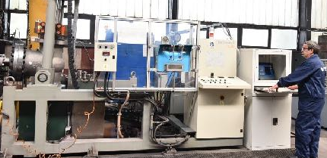
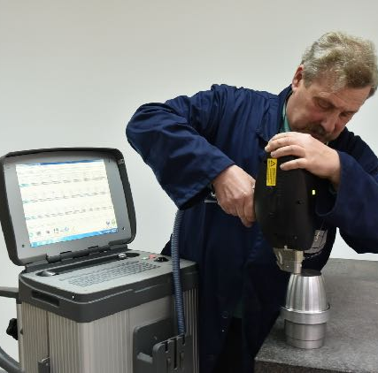
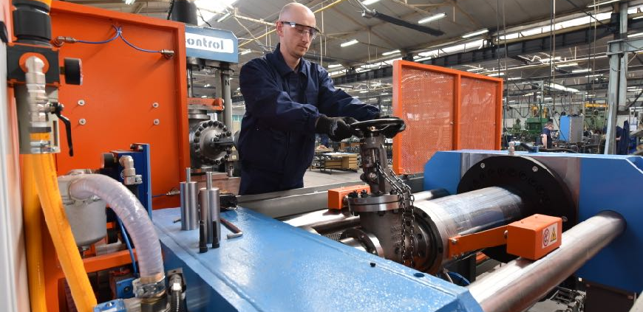
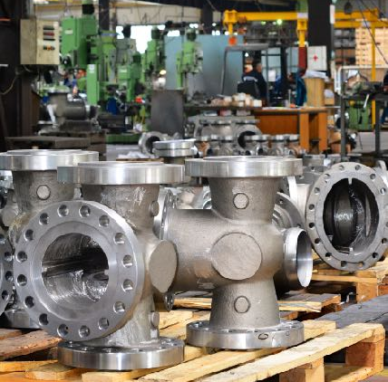
100% Testing
In keeping with the pertinent standard, every single product is tested. A unique identification number on each product allows a full traceability of all activities and material consumption.

Slide 15
Mesuring
& Control Equipment
Test bench up to 1600 bar (up to 6 bar with air)
Test bench up to 650 bar (up to 6 bar with air)
Test bench up to 500 bar (up to 6 bar with air)
Test bench for hydraulic testing up to 1000 bar
Spectrometers for chemical analysis of materials (PMI)
Reliable Quality Maintenance and on-going improvement of products quality are a commitment and responsibility of all company employees. A reliable and quality product is our priority, and a satisfied customer - our objective in continuity.
Equipment for ultrasonic examination
Equipment for magnetic particle examination
Equipment for wall thickness measuring
Hardness testing equipment
Equipment for coating thickness measuring
Equipment for liquid penetrant examination

Slide 16
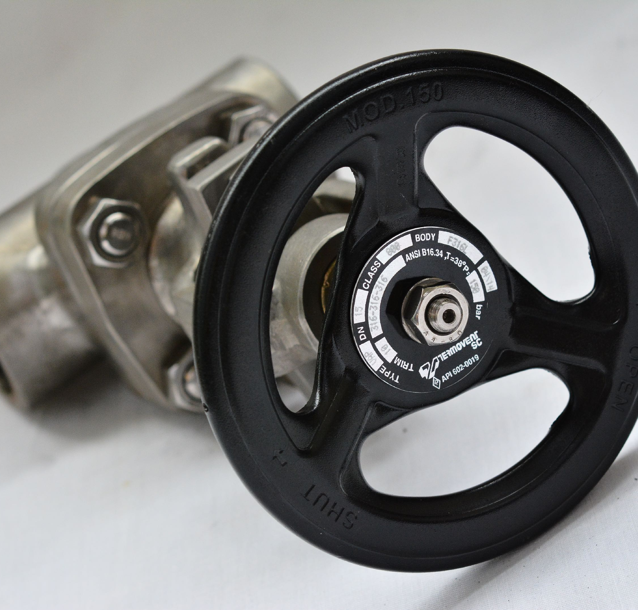
Quality System
We pay special attention to the application of current international rules and standards in quality system development. We keep improving and maintaining a high level of the quality system through active education.
We have the following valid certificates:
ТР ТС 032/2013
ТР ТС 010/2011
ТР ТС 012/2011
TÜV InterCert ISO 9001-2015
EN ISO 3834
AD-2000 Merkblatt HP 0
PED 2014/68/EU – Module H1
API Certificates
API 6A - 1129
API 6D - 1049
API 600 - 0096
API 602 - 0019

Slide 17
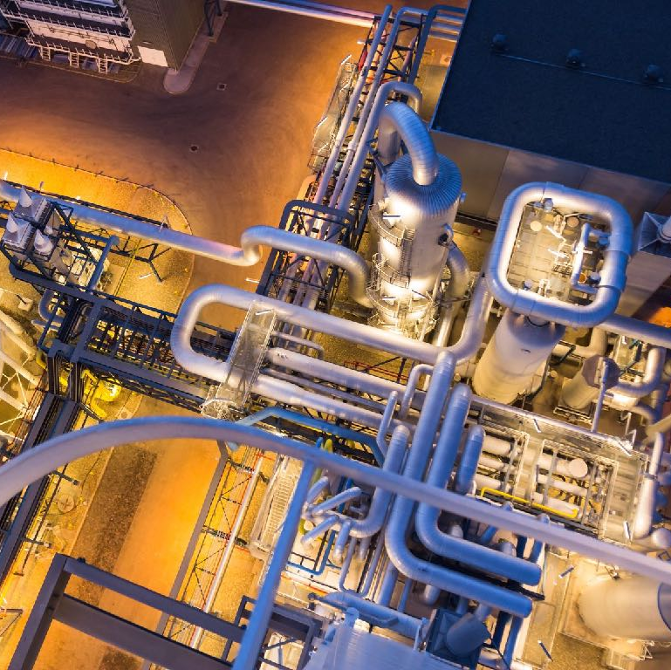
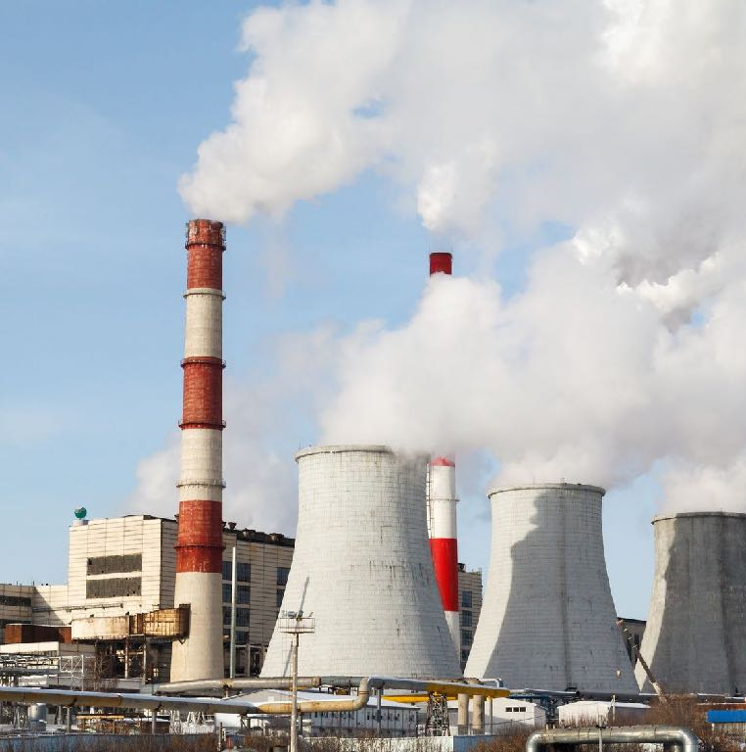
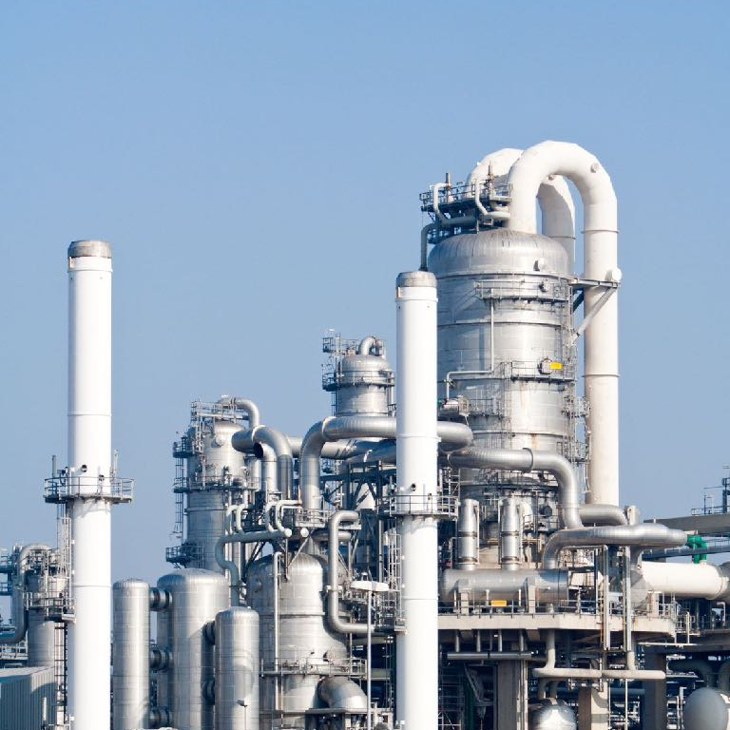
Fields of Application
Valves
Energetics
Thermal Power Plants
Hydroelectric Power Plants
Heating Stations
Boilers Production
Process Industry
Ironworks
Smeltery
Cement Industry
Paper Industry
Heating and Cooling Systems
Production of Agricultural Fertilizers
Sugar Refineries
Chemical Plants
Petrochemical Plants
Oil & Gas
Oil & Gas Exploitation
Oil & Gas Pipelines
Oil Refineries And Oil Processing
Pumping Stations & Tanks

Slide 18
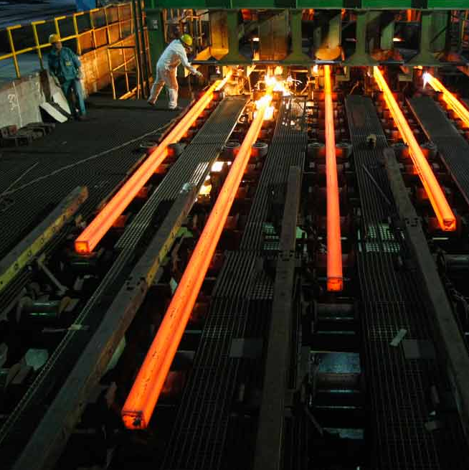
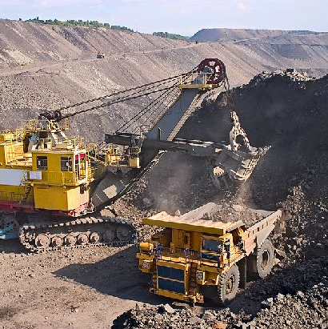
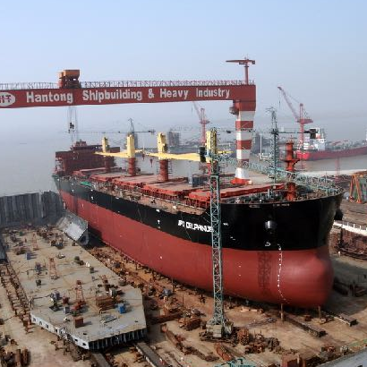
Fields of Application
Castings
Thermal Power Plants
Production of Machines and Tools
Cement Industry
Mines and Ironworks
Construction (Building) Industry
Railways
Automotive Industry
Agricultural Mechanization
Shipbuilding
Valves Industry

Slide 19
Foundry Capacity
cca. 3.000 ton yearly

Slide 20
Steel Foundry Materials
Stainless Steels
GX5CrNi19-10
GX5CrNiMo19-11-2
GX5CrNiMoNb19-11-2
GX5CrNiNb19 11
GX12Cr12
CF8
CF8M
CF8C
12X18H9T
12X18H12M3T
Alloy Steels
G20Mo5
G17CrMo5-5
G17CrMo9-10
G24CrMo4
4A
4C
WC1
WC6
WC9
C5
C12A
CA15
G35CrNiMo6-6
G32NiCrMo8-5-4
Carbon Steels
GE300
GP240GH
WCB
LCB
20L
Wear Resistant Steel
G20Mn5
GX120Mn13
GX120Mn18-2
Heat Resistant Steels
GX40CrNiSi27-4
GX40CrNiSi 25-20
GX130CrSi29
Abrasive Resistant Steels
GX300CrMo15 3
GX300CrMo27 1
Other materials acc. to EN or ASTM Standards

Slide 21
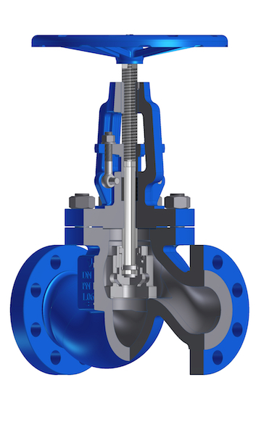
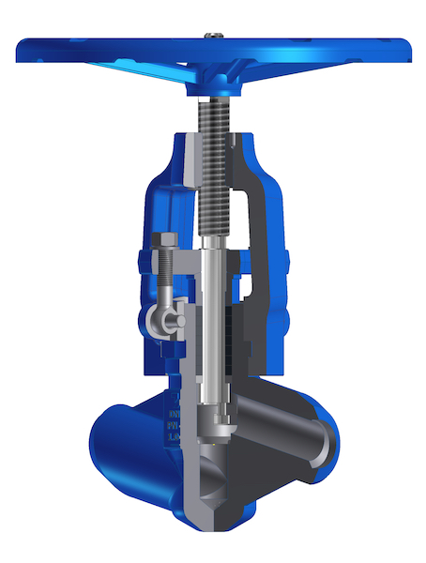
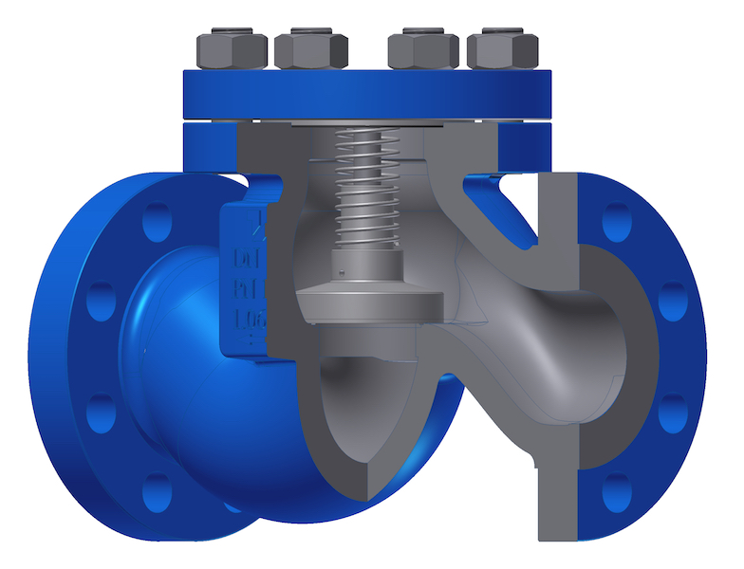
Production
Range
Globe Valves
Gate Valves
Check Valves
Oil & Gas Exploitation Products
Other Types of Products

Slide 22
Globe Valves
Globe Valve EN 13709
Type | VENS
DN | 15 ÷ 350
Rating | PN 16 ÷ 160
Standard Materials
1.0460, 1.0565, 1.5415, 1.7335, 1.4301, 1.4541, 1.4404 |  | 1.0619, 1.6220, 1.5419, 1.7357, 1.4308, 1.4408
High Pressure Globe Valve
Type | VHP
DN (NPS) | 10 (⅜″) ÷ 200 (8″)
Rating | PN 250 ÷ 500 Cl 1500 ÷ 2500
Standard Materials
1.0460, 1.5415, 1.7335, 1.7383, 1.4903, 1.4301, 1.4541, 1.4404 |  | A105, F1, F12 Cl.2, F22 Cl.3, F91, F304, F321, F316

Slide 23
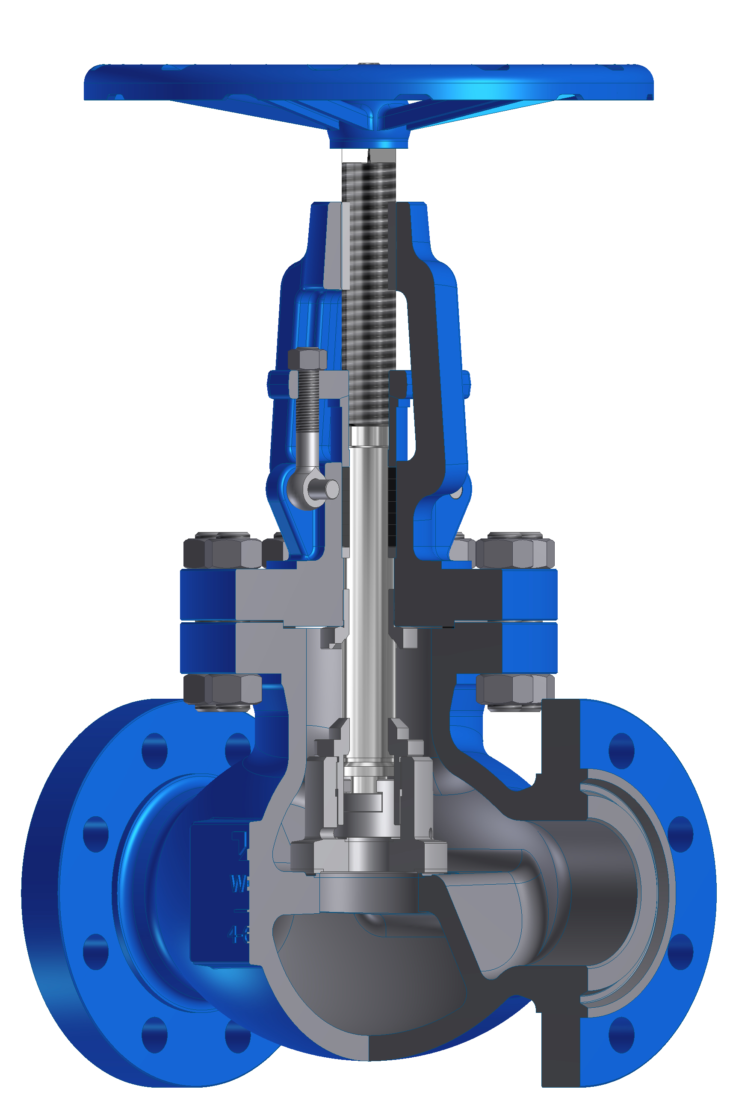
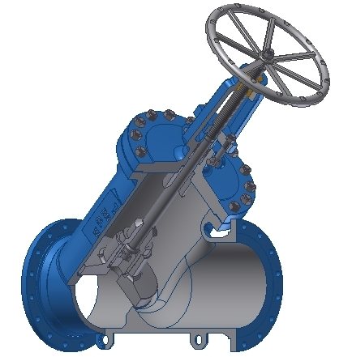
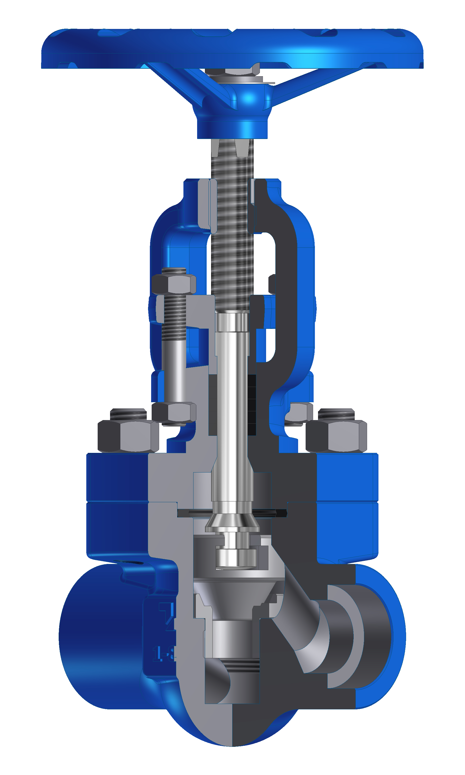
Globe Valve BS 1873
Type | VBS
DN (NPS) | 50 (2″) ÷ 250 (10″)
Rating | Cl 150 ÷ 900
Standard Materials
WCB, LCB, LCC, LC1, WC6, CF8, CF8M
Globe Valve Y type BS 1873
Type | VBSY
DN (NPS) | 15 (½″) ÷ 500 (20″)
Rating | Cl 150 ÷ 300
Standard Materials
WCB, LCB, LCC, LC1, WC6, CF8, CF8M
Globe Valve API 602
Type | VAP
DN (NPS) | 8 (¼″) ÷ 50 (2″)
Rating | Cl 150 ÷ 1500
Standard Materials
A105, LF2, F12 Cl.2, F22 Cl.3, F5, F91, F304, F321, F347, F316
Other materials acc. to EN or ASTM Standards

Slide 24
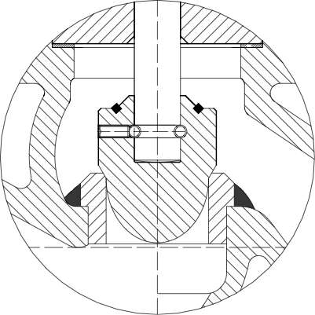
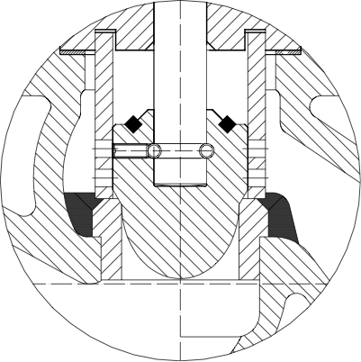
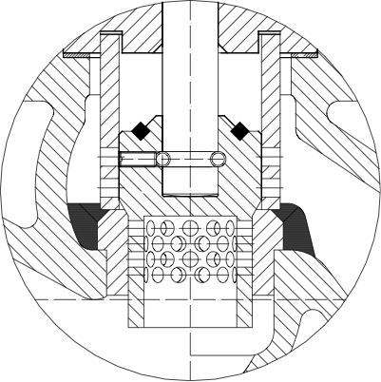
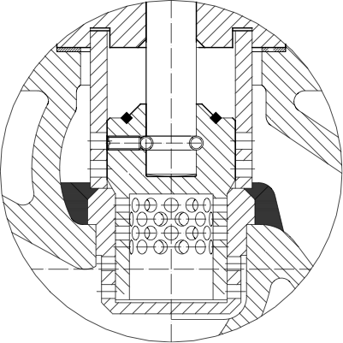
Control Valves
1 Stage design
with Parabolic Plug
2 Stage design
with Parabolic Plug and Anti-Cavitation Cage
With equal percentage or linear flow characteristic
2 Stage design
with Perforated Plug and Silencer
3 Stage design
with Perforated Plug, Seat and Anti-Cavitation Cage

Slide 25
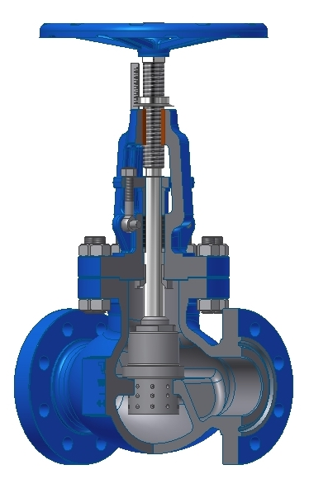
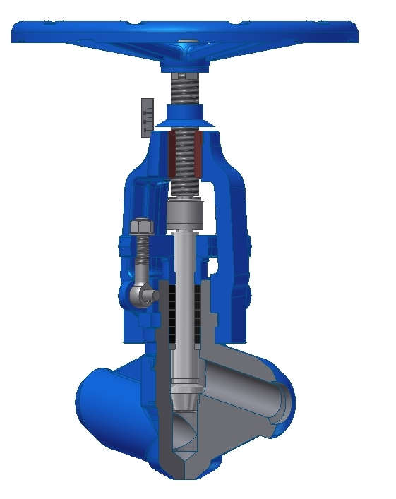
Control Valve EN 1349
Type | VENR
DN | 15 ÷ 350
Rating | PN 16 ÷ 160
Standard Materials
1.0460, 1.0565, 1.5415, 1.7335, 1.4301, 1.4541, 1.4404 1.0619, 1.6220, 1.5419, 1.7357, 1.4308, 1.4408
Control Valve BS Std.
Type | VBR
DN (NPS) | 50 (2″) ÷ 250 (10″)
Rating | Cl 150 ÷ 900
Standard Materials
WCB, LCB, LCC, LC1, WC6, CF8, CF8M
High Pressure Control Valve
Type | VHPR
DN (NPS) | 10 (⅜″) ÷ 200 (8″)
Rating | PN 250 ÷ 500 Cl 1500 ÷ 2500
Standard Materials
1.0460, 1.5415, 1.7335, 1.7383, 1.4903, 1.4301, 1.4541, 1.4404 |  | A105, F1, F12 Cl.2, F22 Cl.3, F91, F304, F321, F316
Other materials acc. to EN or ASTM Standards

Slide 26
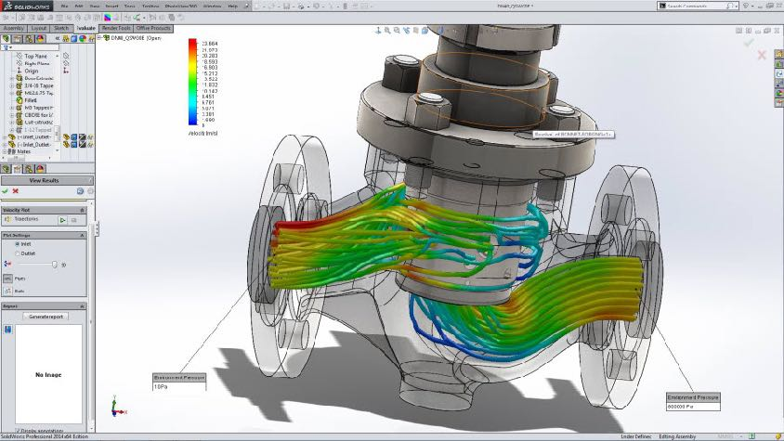
SolidWorks® Flow Simulation
The SolidWorks® Flow Simulation provides the advanced capabilities we need to get to market faster—designers can catch mistakes sooner, change course quickly, and create better-performing products at a lower cost.
Engaging SolidWorks® Flow Simulation intuitive Computational Fluid Dynamics (CFD) in production process, enables TERMOVENT SC designers to simulate liquid and gas flow in real -world conditions, run “what if” scenarios, and effciently analyze the effects of liquid flow, heat transfer, and related forces on immersed or surrounding components.
Early in the design process, our designers can easily simulate liquid flow, heat transfer, and liquid forces that are critical to the success of the product design.

Slide 27
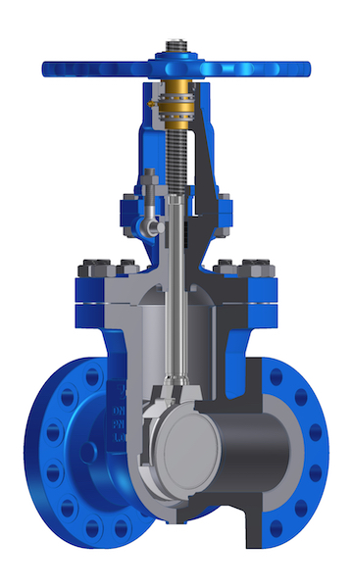
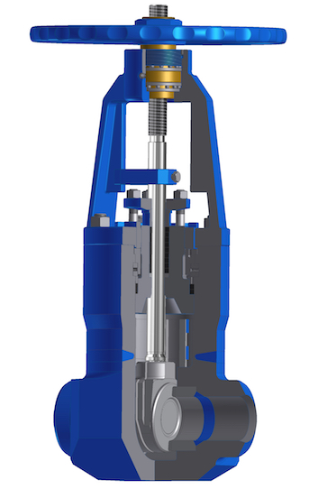
Gate Valves
Gate Valve EN 1984
Type | GEN
DN | 50 ÷ 600
Rating | PN 16 ÷ 160
Standard Materials
1.0619, 1.6220, 1.5419, 1.7357, 1.4308, 1.4408
High Pressure Gate Valve
Type | GHP
DN (NPS) | 10 (⅜″) ÷ 300 (12″)
Rating | PN 250 ÷ 400 Cl 900 ÷ 2500
Standard Materials
1.0460, 1.5415, 1.7335, 1.7383, 1.4903, 1.4301, 1.4541, 1.4404, |  | A105, F1, F12 Cl.2, F22 Cl.3, F91, F304, F321, F316,
1.0619, 1.6220, 1.7357, 1.7379, C12A, 1.4308, 1.4408 |  | WCB, WC1, WC6, WC9, C12A, CF8, CF8C, CF8M

Slide 28
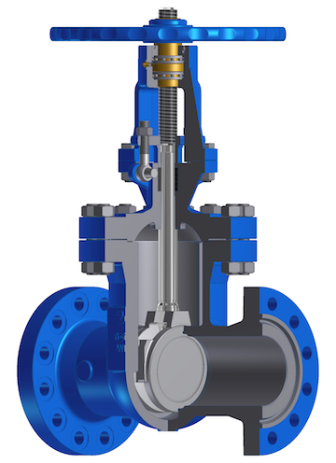
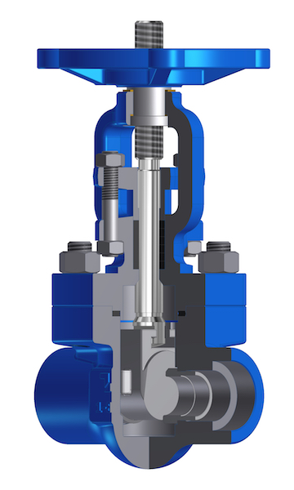
Gate Valve API 600
Type | GAC
DN (NPS) | 50 (2″) ÷ 650 (26″)
Rating | Cl 150 ÷ 1500
Standard Materials
WCB, LCB, LCC, LC1, WC6, CF8, CF8C, CF8M
Gate Valve API 602
Type | GAF
DN (NPS) | 8 (¼″) ÷ 50 (2″)
Rating | Cl 150 ÷ 1500
Standard Materials
A105, LF2, F12 Cl.2, F22 Cl.3, F5, F91, F304, F321, F347, F316
Other materials acc. to EN or ASTM Standards

Slide 29
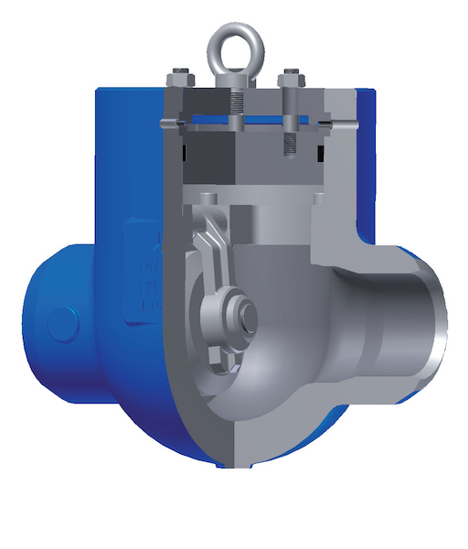
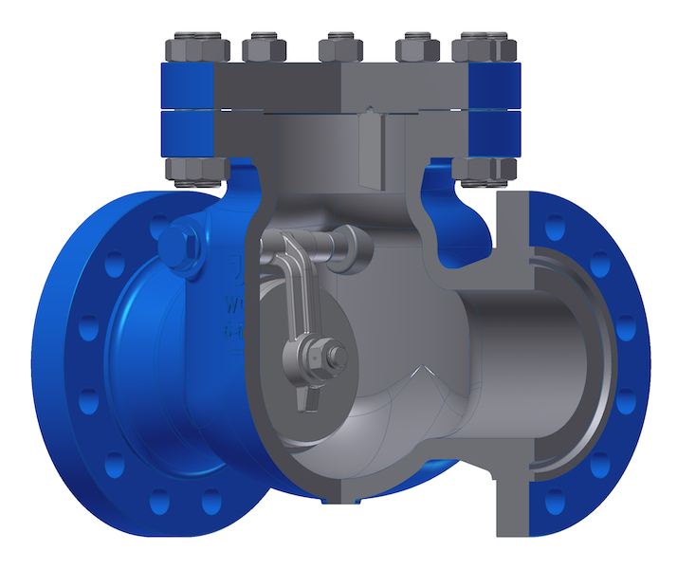
Check Valves
Lift Check Valve EN 14341
Type | CLEN
DN | 15 ÷ 350
Rating | PN 16 ÷ 160
Standard Materials
1.0460, 1.0565, 1.5415, 1.7335, 1.4301, 1.4541, 1.4404 |  | 1.0619, 1.6220, 1.5419, 1.7357, 1.4308, 1.4408
High Pressure Swing Check Valve
Type | CHPS
DN (NPS) | 10 (⅜″) ÷ 200 (8″)
Rating | PN 250 Cl 1500
Standard Materials
1.0619, 1.6220, 1.7357, 1.7379, C12A, 1.4308, 1.4408 |  | WCB, WC1, WC6, WC9, C12A, CF8, CF8C, CF8M
1.0460, 1.5415, 1.7335, 1.7383, 1.4903, 1.4301, 1.4541, 1.4404, |  | A105, F1, F12 Cl.2, F22 Cl.3, F91, F304, F321, F316,
Swing Check Valve BS 1868
Type | CSBS
DN (NPS) | 15 (½″) ÷ 600 (24″)
Rating | Cl 150 ÷ 900
Standard Materials
WCB, LCB, LCC, LC1, WC6, CF8, CF8M
Other materials acc. to EN or ASTM Standards

Slide 30
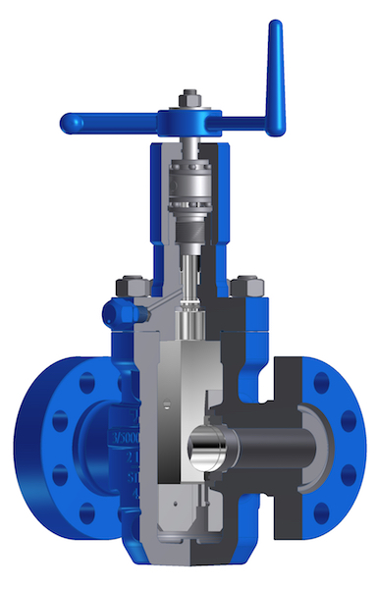
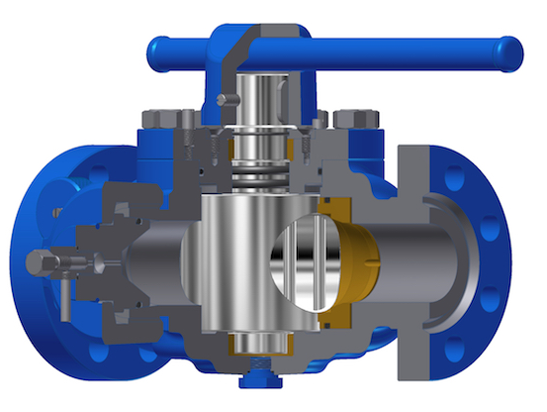
Oil & Gas Exploitation
Products
Xmass Tree Gate Valve API 6A
Type | GXT
DN (NPS) | 50 (2 1/16″) ÷ 100 (4 1/16″)
Rating | 2000 ÷ 5000 psi
Standard Materials
4A, CA15
Pig Valve API 6D
Type | CPVP
DN | 50 (2″) ÷ 150 (6″)
Rating | Cl 600 ÷ 1500
Standard Materials
WCB, LCB, LC1, LC2, CA15, CF8, CF8M

Slide 31
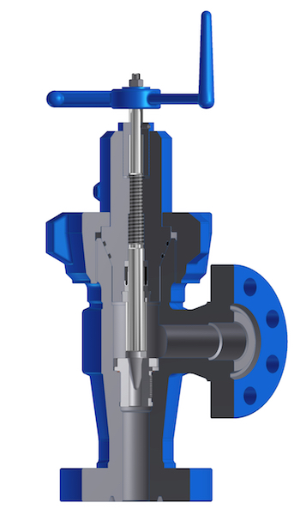
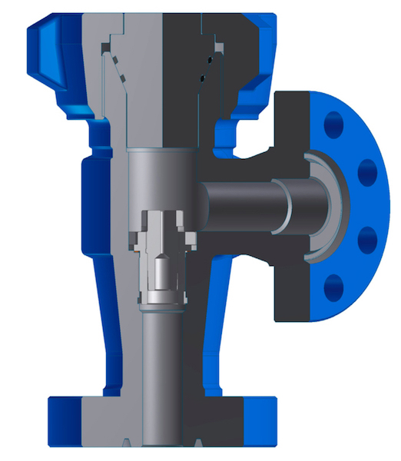
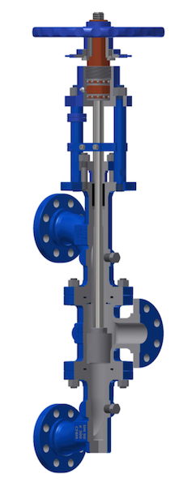
Adjustable Choke API 6A
Type | VAC
DN (NPS) | 50 (2 1/16″)
Rating | 2000 ÷ 5000 psi
Standard Materials
4A, CA15
Positive Choke API 6A
Type | VPC
DN (NPS) | 50 (2 1/16″)
Rating | 2000 ÷ 5000 psi
Standard Materials
4A, CA15
Change Over Valve
Type | COV
DN (NPS) | 50 (2″) ÷ 200 (8″)
Rating | Cl 150 ÷ 900
Standard Materials
WCB, LCB, LCC, CF8, CF8M
Other materials acc. to EN or ASTM Standards

Slide 32
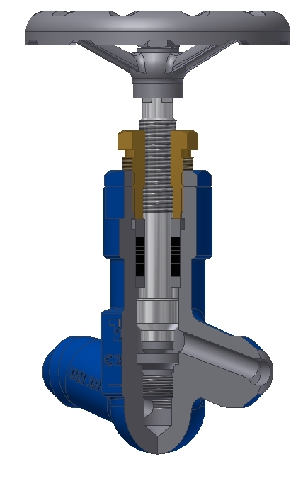
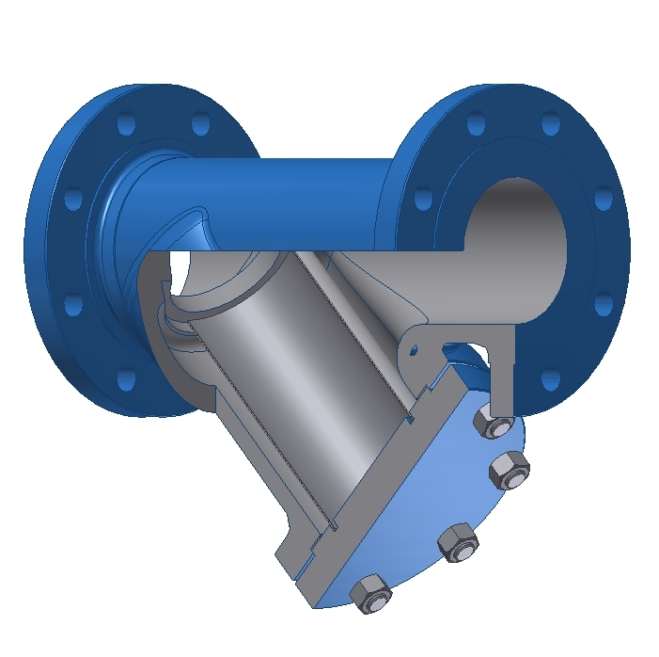
Other Types of Products
Needle Valve
Type | VNS
DN | 6 ÷ 15
Rating | PN 16 ÷ 630
Standard Materials
1.0460, 1.0565, 1.5415, 1.7335, 1.7383,1.4903,1.4301, 1.4541, 1.4404
Strainer Y type
Type | SBSY
DN (NPS) | 15 (½″) ÷ 500 (20″)
Rating | Cl 150 ÷ 300
Standard Materials
WCB,LCB,WC1,WC6,WC9, C12A,CF8,CF8C

Slide 33
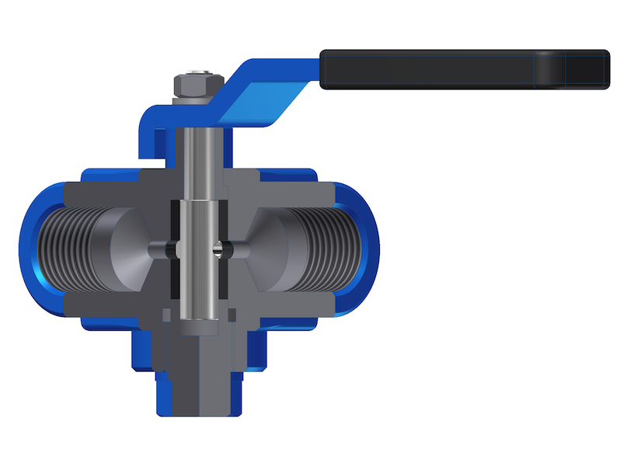
Cock for Pressure Gauge
Type | CPG
DN | 15 ÷ 20
Rating | PN 16 ÷ 160
Standard Materials
1.0460, 1.4301,1.4404
Plug Valve
Type | CPV
DN (NPS) | 15 (½″) ÷ 300 (12″)
Rating | PN16 ÷ 100 Cl 150 ÷ 600
DN (NPS) 15 (½″) ÷ 50 (2″) Rating Cl 600
Standard Materials
A105, LF2, 304, F321, F316, HASTELLOY B2 WCB,LCB, CF8, CF8C, CF8M
Other materials acc. to EN or ASTM Standards

Slide 34
Optional Execution
Globe Valves
Gear operated
Extended stem
Extended bonnet
Chain operated
Limit switches
Locking device
Position indicator
Electric actuator
Hydraulic actuator
Pneumatic actuator
Inside screw rising stem (ISRS)
Spring loaded stuffing box

Slide 35
Optional Execution
Gate Valves
2 piece split wedge
Gear operated
Extended stem
Extended bonnet
Chain operated
Solid wedge
Limit switches
Locking device
Position indicator
Electric actuator
Hydraulic actuator
Pneumatic actuator
Overpressure safety device
Spring loaded stuffing box

Slide 37
Thank You!
termoventsc.rs / E-mail: office@termoventsc.rs / Termovent SC, Serbia 2019

